Slide 1

Python & Data Science Training Project 3 – Home Price Changes in Southern California

Slide 2
Purpose of the Study
This project will do the following:
Impact of interest rate on mortgage originations?
Impact of interest rate on home prices?
Tracking home price changes in southern California for four years (2018/01 to 2021/12).

Slide 3
Link to the file for the project
- Program 4.1 will process 55GB of data and requires a lot of computing power.
- If your computer is not powerful to run 4.1 of the Jupyter Notebook, you can skip 4.1 and directly use 4.2 after downloading the zipped data from the following link:
https://1drv.ms/u/s!Amfo1lixPzv-j3d8Ft7z2lWyGMwq?e=vChMsW
There are 18 files after you have unzipped it. 16 files are mortgage origination files from 2018/01 to 2021/12.

Slide 4
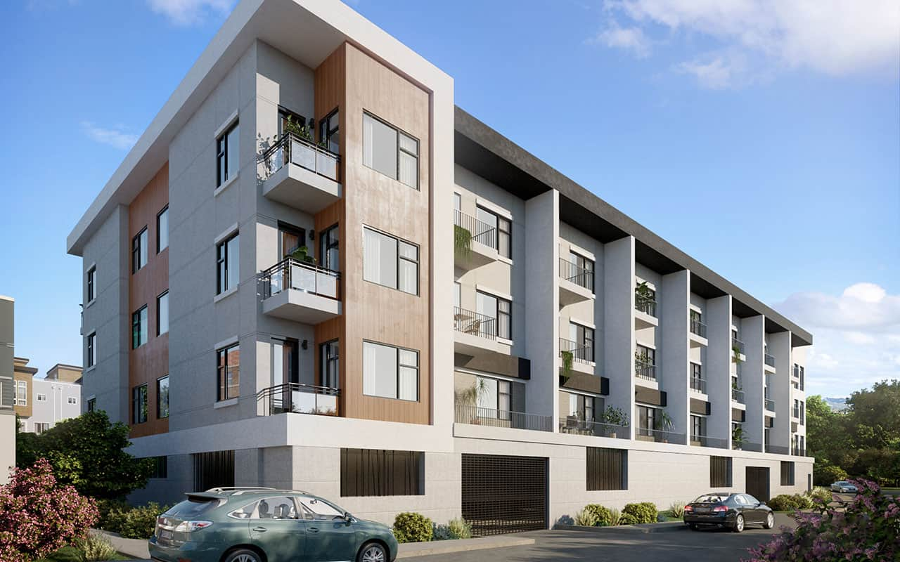


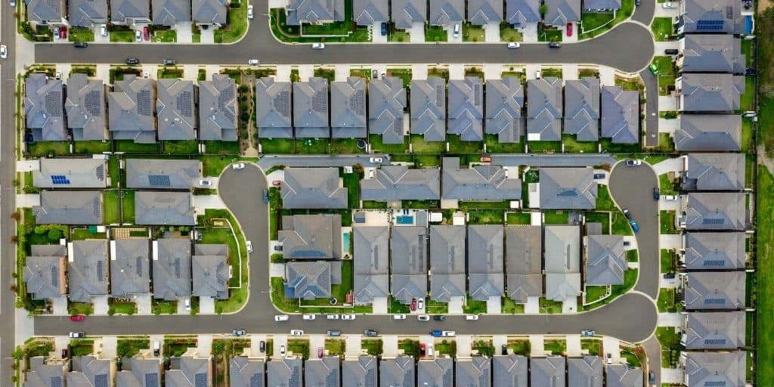
Domain knowledge 1 - Common property types in the US
single family home
condo
Pud: planned unit development
Usually without a parking garage.
Shared parking space with others.
- Townhome or detached condo
- Usually with a parking garage

Slide 5
Domain knowledge 3 - Terms used to define loan performance
Current: in good standing. A borrower pays online every month.
Delinquency
Bucket 1: 30-day past due
Bucket 2: 60-day past due
……
Bucket 6 (charge off): 180 day past due
Foreclosure: when a borrower fails to make payments for too many months, the lender (usually a bank) seizes the property for repossession. That is, the borrower loses the house.
Forbearance: When a borrower encounters some financial stress, he/she negotiates with the borrower for a more lenient term (lower interest rate, pause of payments for some months, temporary paying for interest only, short sale, etc.)
Also used for credit card, car loans, student loans, car loans and personal loans

Slide 6
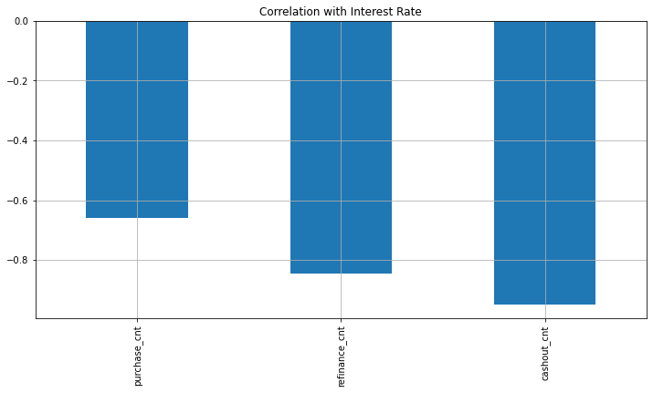
Domain knowledge 2 - Factors used in considering a loan application
FICO score
Loan Purpose
Purchase (less sensitive to interest changes. 刚需）
Relocation to a new place
Getting married
Rate refinance (very sensitive to interest rate)
When interest rate drops, a refinance can low down mortgage payment.
Cash out refinance (very sensitive to interest rate)
Example: A house of $1mm with $600 in unpaid principal (loan amount).
The borrower can get $50K from the bank to finance remodeling.
His/her new unpaid principal is now $650K.
Interest only loans (no payment for principal)
LTV (loan-to-value ratio) <= 80%
LTV=loan amount / house selling value
DTI (debt-to-income ratio) <= 42%
DTI=debt payment /Income (pre tax income)

Slide 7
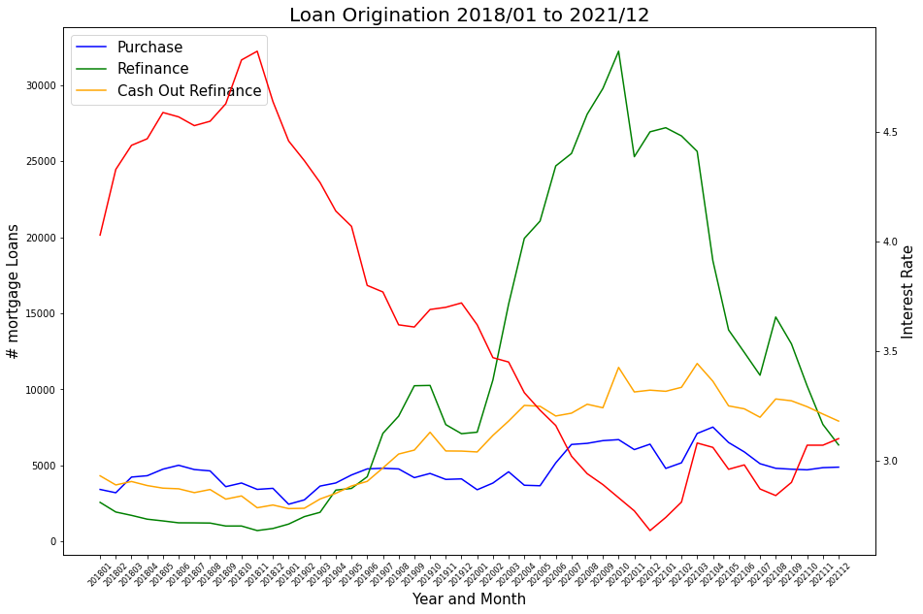
Example of visualization

Slide 8
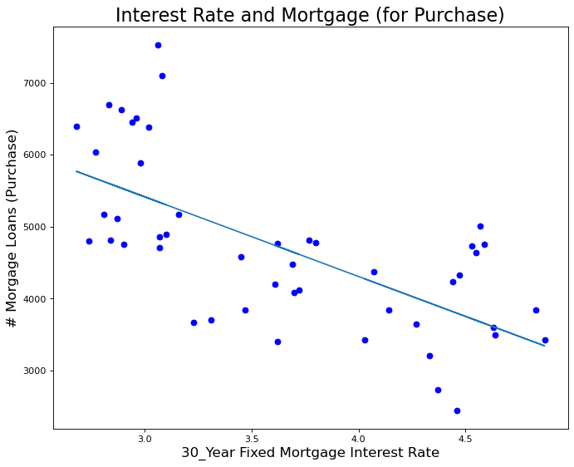
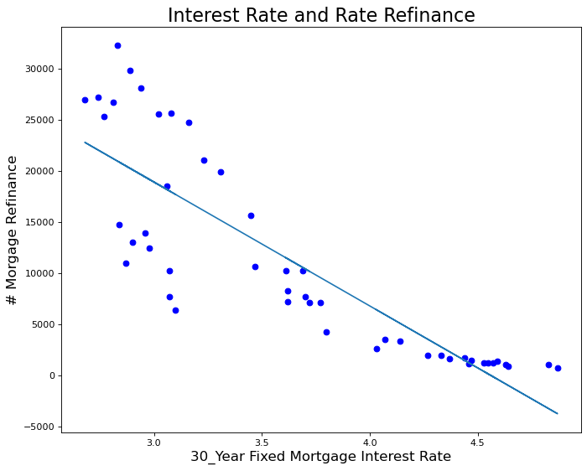
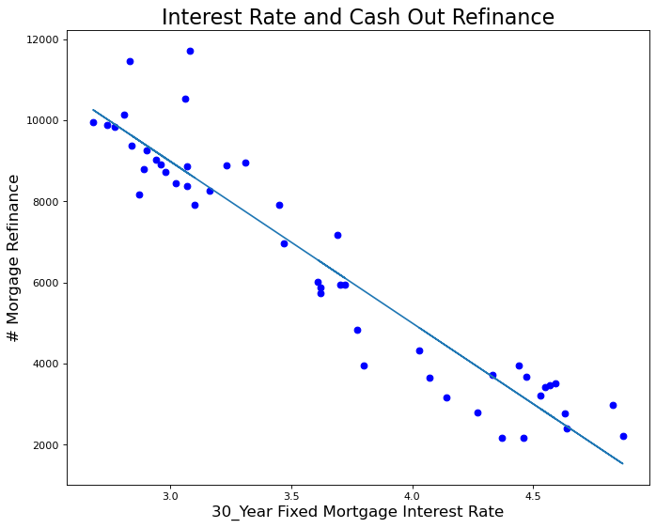
Example of visualization FICO and loan performance

Slide 9
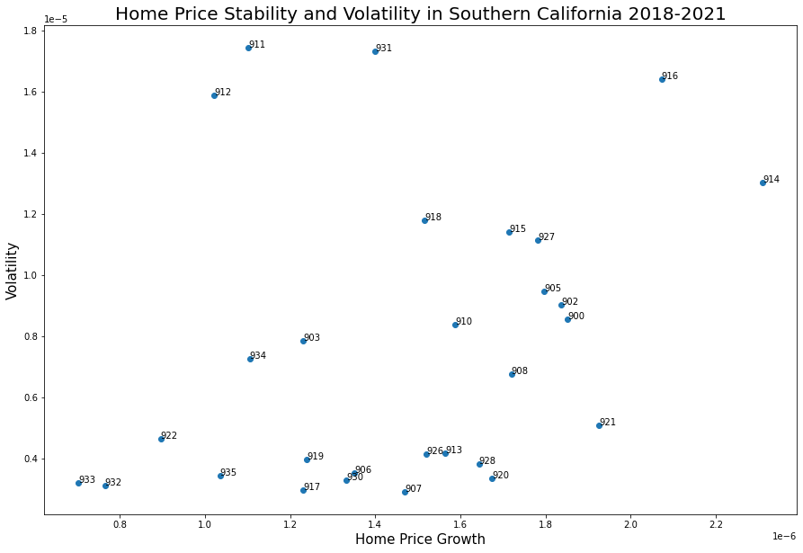
Example of visualization
Each data point on the graph is labeled by the first 3 digits of the zip codes in southern California.

Slide 10
Case-Shiller Index
Ideally, if we can track the price changes of each house every month, we can know the change of house prices.
But there’s no way we will trade our house every month.
Practically, we can do the following:
Take zip code 90101 as an example, if in 2018/01 there were 1000 houses sold, get median sell price, for example, $600,000. 2018/02 there were 870 houses sold, get median sell price, for example, $620,000. Normally, the two prices would not reflectthe same housing price. Then the change of house price would be ($620,000 - $600,000) / $600,000 = $20,000 / $600,000 = 3.33%. This is value is widely used in mortage industry and also news reporting.

